Slide 1
Group Discussion
2017/03/01

Slide 2
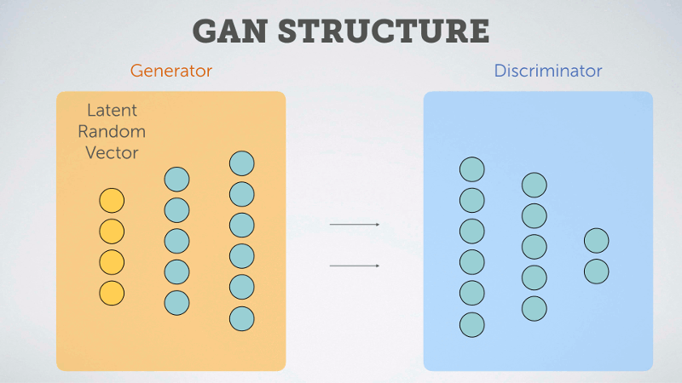
Recall: generative adversarial networks (GAN) framework

Slide 3
GAN Frameworks
GAN包含一个判别器(D, discriminator)与一个生成器(G, generator)。 Pr 是真实样本分布，Pg 是由生成器产生的样本分布。
判别器的目的是把真实样本分为正例、生成样本分为负例。 损失函数为
L_{D}=−E_{x∼Pr}[logD(x)]− E_{x∼Pg}[log(1−D(x))] (1)
生成器的目的是生成更真实的样例，使判别器分为正例. Goodfellow 先后提出了两个损失函数，分别是
L_{G1} = E_{x∼Pg} [log(1−D(x))] (2)
L_{G2} = E_{x∼Pg} [−log(D(x))] (3)

Slide 4
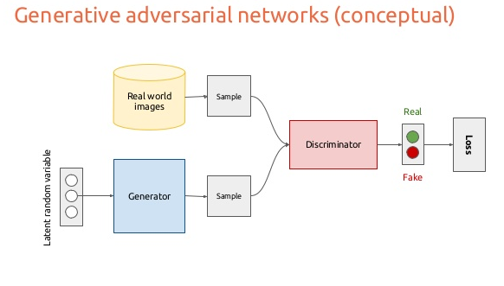
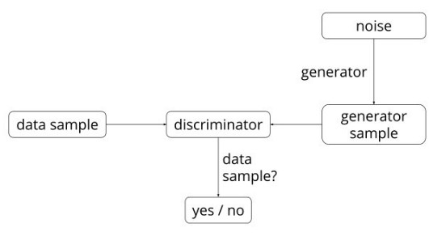
GAN Frameworks
GAN算法框图
代价函数：
其实是将两个loss拼起来了，而且省去了一部分。有了目标函数，训练则是交替的训练。简单说，就是一步固定G，训练D，然后固定D，训练G。作者提到，为了防止”the Helvetica scenario”，要训练D多步，然后训练G一步。

Slide 5
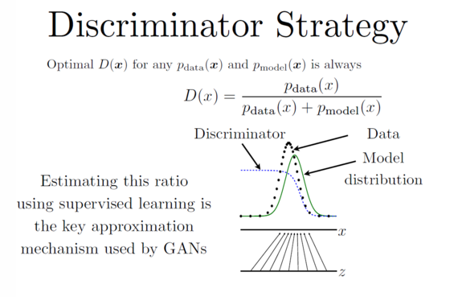
Ian Goodfellow NIPS 2016演讲
http://www.iangoodfellow.com/presentations.html
http://www.tuicool.com/articles/BbauA3z
如图，我们有真实数据（黑色点，data）和模型生成的伪数据（绿色线，model distribution，由 z 映射过去的）（画成波峰的形式是因为它们都代表着各自的分布，其中纵轴是分布，横轴是我们的 x）。我们要学习的 D 就是那条蓝色的点线，这条线的目的是把融在一起的 data 和 model 分布给区分开。写成公式就是 data 和 model 分布相加做分母，分子则是真实的 data 分布。
我们最终要达到的效果是：D 无限接近于常数 1/2。换句话说就是要 Pmodel 和 Pdata 无限相似。这个时候，我们的 D 分布再也没法分辨出真伪数据的区别了。这时候，我们就可以说我们训练出了一个炉火纯青的造假者（生成模型）。

Slide 6
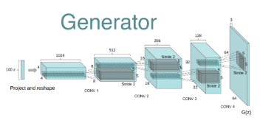
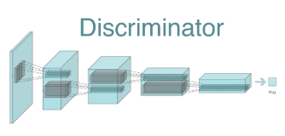
DCGAN 深度卷积生成对抗网络
Deep Convolutional Generative Adversarial Network
DCGAN的原理和GAN一样，只是把G和D换成了两个卷积神经网络（CNN）。
DCGAN对卷积神经网络的结构做了一些改变，以提高样本的质量和收敛的速度
DCGAN网络示意

Slide 7
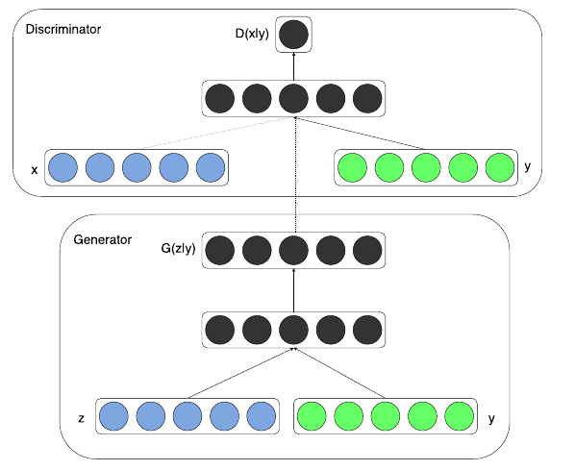
Conditional Generative Adversarial Nets
GAN太过自由(不要求假设数据分布，即不需要formulate p(x))，一个想法是给GAN加一些约束，于是便有了CGAN。
这项工作提出了一种带条件约束的GAN，在生成模型（D）和判别模型（G）的建模中引入条件变量y（conditional variable y），使用额外信息y对模型增加条件，指导数据生成过程。
这些条件变量y可以基于多种信息，例如类别标签，用于图像修复的部分数据，来自不同模态（modality）的数据
D(x|y)
x
y
z
y

Slide 8
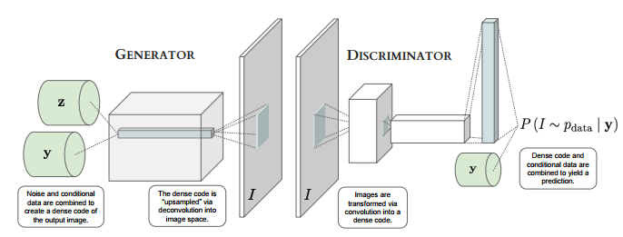
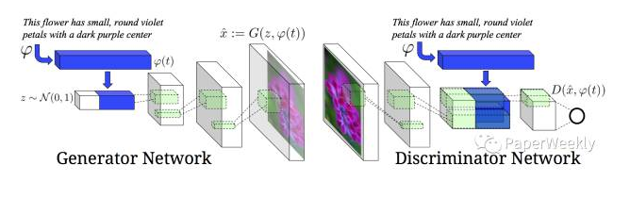

Slide 9
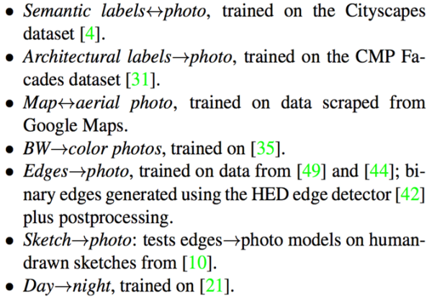
Image-to-Image Translation with Conditional Adversarial Networks
https://arxiv.org/pdf/1611.07004v1.pdf
https://phillipi.github.io/pix2pix/
http://affinelayer.com/pix2pix/index.html

Slide 10
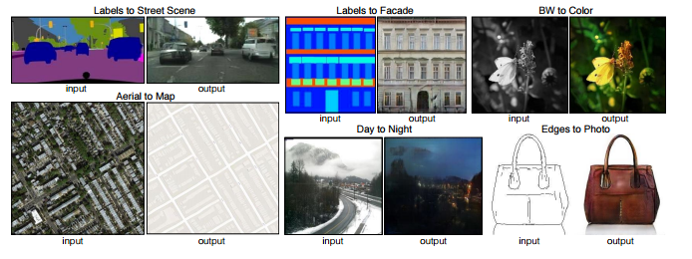

Slide 11
InfoGAN
https://arxiv.org/pdf/1606.03657.pdf
InfoGAN 的出发点是，既然 GAN 的自由度是由于仅有一个 noise z，而无法控制 GAN 如何利用这个 z, 那么我们尽量去想办法在 “如何利用 z” 上做文章。于是将 z 做了拆解，认为 GAN 中生成模型（G）应该包含的 “先验” 分成两种：
（1）不能再做压缩的 noise z；
（2）和可解释地、有隐含意义的一组隐变量 c_1, c_2, …, c_L，简写为 c 。
思想主要是，当我们学习生成图像时，图像有许多可控的有含义的维度，比如笔划的粗细、图片的光照方向等等，这些便是 c ；而剩下的不知道怎么描述的便是 z 。

Slide 12
InfoGAN
实际上是希望通过拆解先验的方式，让 GAN 能学出更加 disentangled 的数据表示（representation），从而既能控制 GAN 的学习过程，又能使得学出来的结果更加具备可解释性。为引入这个 c ，[7] 利用了互信息的建模方式，即 c 应该和生成模型 （G）基于 z 和 c 生成的图片，即 G ( z,c )，高度相关 —互信息大。
利 用这种更加细致的隐变量建模控制，infoGAN 可以说将 GAN 的发展又推动了一步。首先，它们证明了 infoGAN 中的 c 对于 GAN 的训练是有确实的帮助的，即能使得生成模型（G）学出更符合真实数据的结果。其次，他们利用 c 的天然特性，控制 c 的维度，使得 infoGAN 能控制生成的图片在某一个特定语义维度的变化

Slide 13
Adversarially Learned Inference
https://ishmaelbelghazi.github.io/ALI/
https://github.com/IshmaelBelghazi/ALI
jointly learns a generation network and an inference network using an adversarial process.
integrate efficient inference with the generative adversarial networks (GAN) framework.

Slide 14
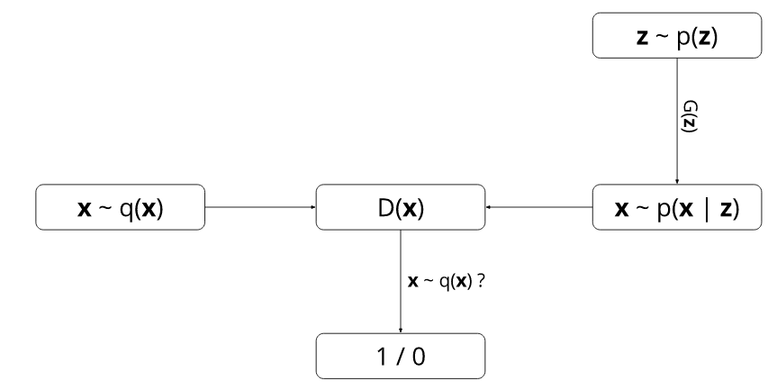
To better understand GANs, it is necessary to describe it using a probabilistic framework. Two marginal distributions are defined:
the data marginal q(x), and the model marginal p(x)=∫p(z)p(x∣z)dz.
The generator operates by sampling z∼p(z) and then sampling x∼p(x|z). The discriminator receives either the generator sample or x∼q(x) and outputs the probability that its input was sampled from q(x).

Slide 15
Learning inference
Even though GANs are pretty good at producing realistic-looking synthetic samples, they lack something very important: the ability to do inference.
Inference can loosely be defined as the answer to the following question:
  Given x, what z is likely to have produced it?
This question is exactly what ALI is equipped to answer.
ALI augments GAN’s generator with an additional network. This network receives a data sample as input and produces a synthetic z as output.
Expressed in probabilistic terms, ALI defines two joint distributions:
  the encoder joint q(x,z)=q(x)q(z∣x), and
  the decoder joint p(x,z)=p(z)p(x∣z).

Slide 16
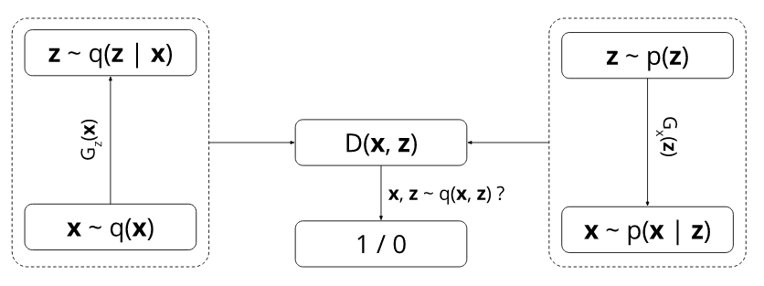
Learning inference
ALI also modifies the discriminator’s goal. Rather than examining xx samples marginally, it now receives joint pairs (x,z) as input and must predict whether they come from the encoder joint or the decoder joint.
Like before, the generator is trained to fool the discriminator, but this time it can also learn q(z∣x)
encoder
decoder

Slide 17
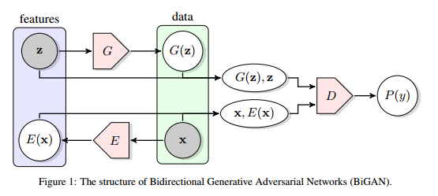
Adversarial Feature Learning
https://arxiv.org/pdf/1605.09782v3.pdf
Bidirectional Generative Adversarial Networks (BiGANs)
latent space
decoder
encoder
GANs lack the ability to retrieve a latent representation given an output.
BiGANs simultaneously learn both an encoder function E that models the encoding process P_{E}(z|y) from the space R^{n} to a latent space R^{Z}, and a generator function G that models the mapping distribution P_{G}(y|z) of any latent point z ∈ R^{Z} to a possible object y ∈ R^{n}

Slide 18
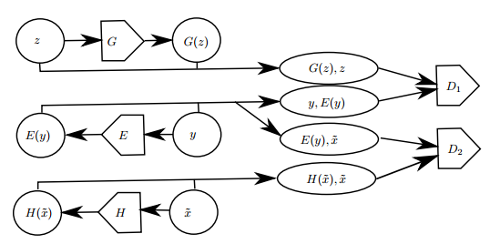
Multi-view Generative Adversarial Networks
https://arxiv.org/pdf/1611.02019.pdf
Learning over multi-view data
based on the BiGAN model, the Multi-view BiGAN (MV-BiGAN) performs density estimation from multi-view inputs
The two top levels correspond to the BiGAN model, while the third level is added to model the distribution over the latent space given the input of the CV-BiGAN. The discriminator D2 is used to constraint P(z|y) and P(z|x˜) to be as close as possible

Slide 19
Summary of ALI
Two networks are trained simultaneously: a generator g(), producing samples from a latent representation z, and an encoder f(), inferring the latent representation from data x coming from the target distribution.
Discrimination is performed between two types of pairs: a pair of generated data and the corresponding latent vector (g(z), z), and a pair of data originating from the target distribution, and the inferred latent representation (x, f(x)). At optimality g() and f() are proven to be inverses.
However, the methods have only been shown to work on low-dimensional inputs and latent representations.

Slide 20
Generative Multi-Adversarial Networks

Slide 21
GAN算法框图

